Slide 1
Kubernetes-K8s
What is Kubernetes?
Purpose of Kubernetes is to host the applications in the form of containers in automated fashion so that you can deploy as many instances of application and easily enable the communication between different services within the application

Slide 2
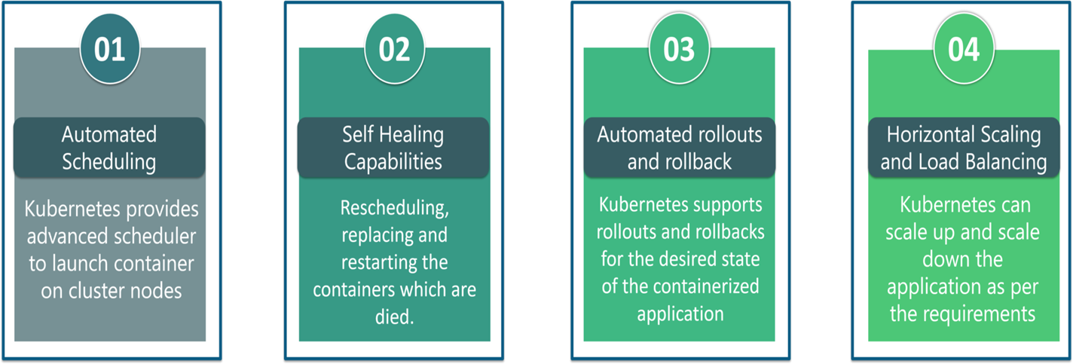
Kubernetes Features

Slide 3
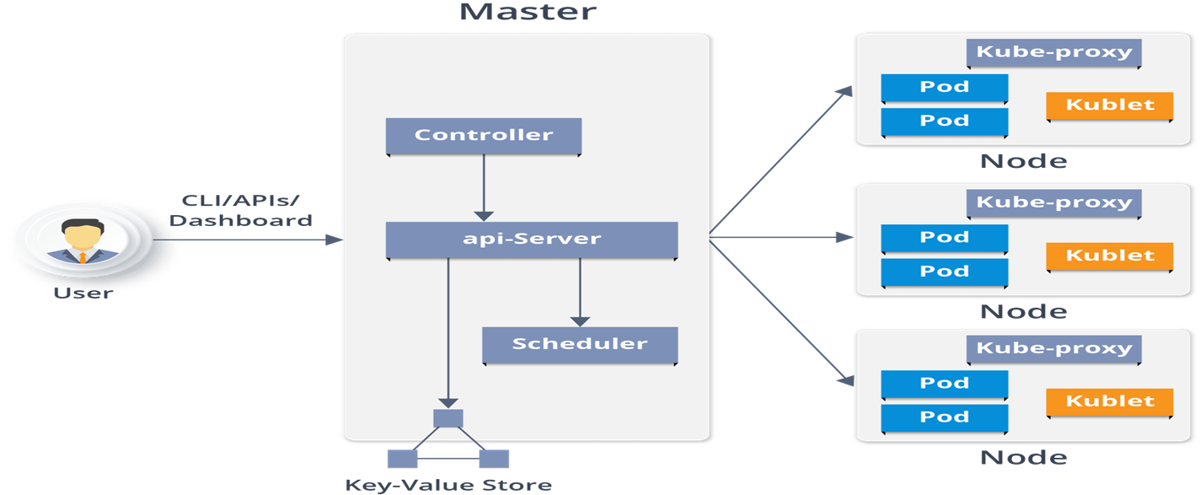
Kubernetes Architecture

Slide 4
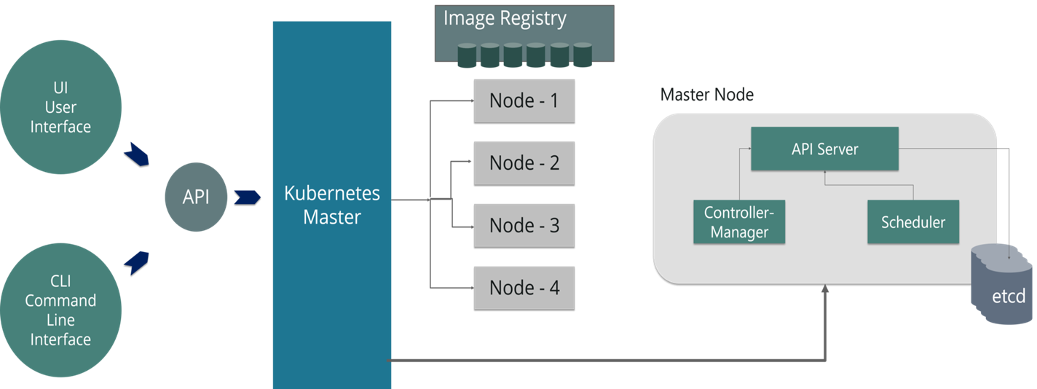
Kubernetes Master Node

Slide 5
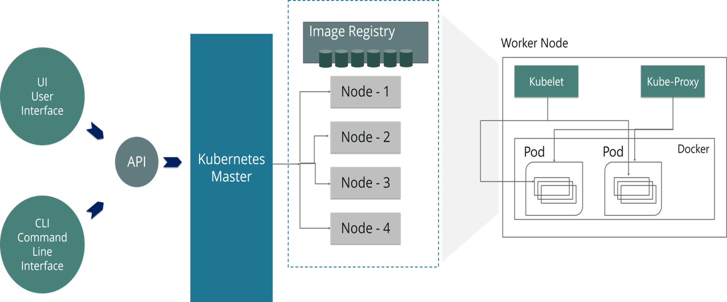
Kubernetes Worker Node

Slide 6
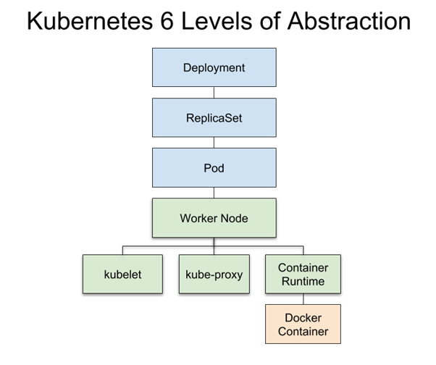
Levels of Abstraction

Slide 7
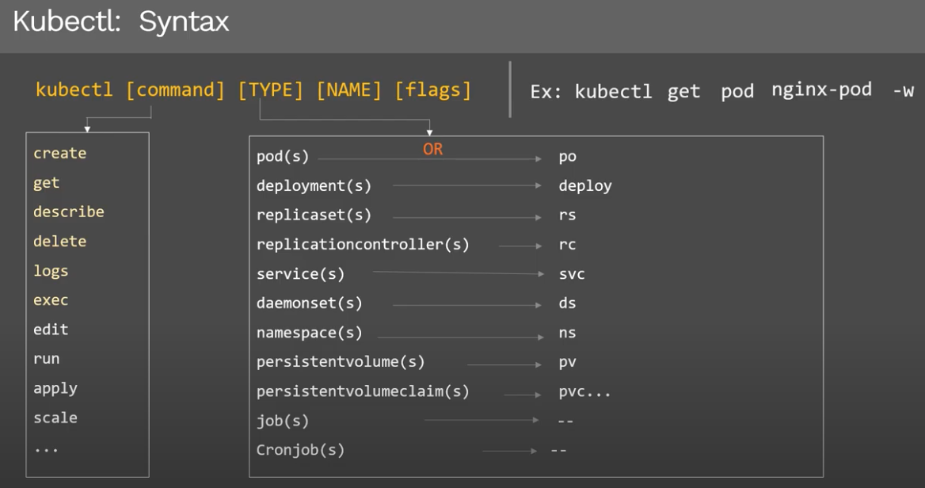
Kubectl Commands

